Slide 1

CAPSTONE PROJECT SALES ANALYTICS

Slide 2
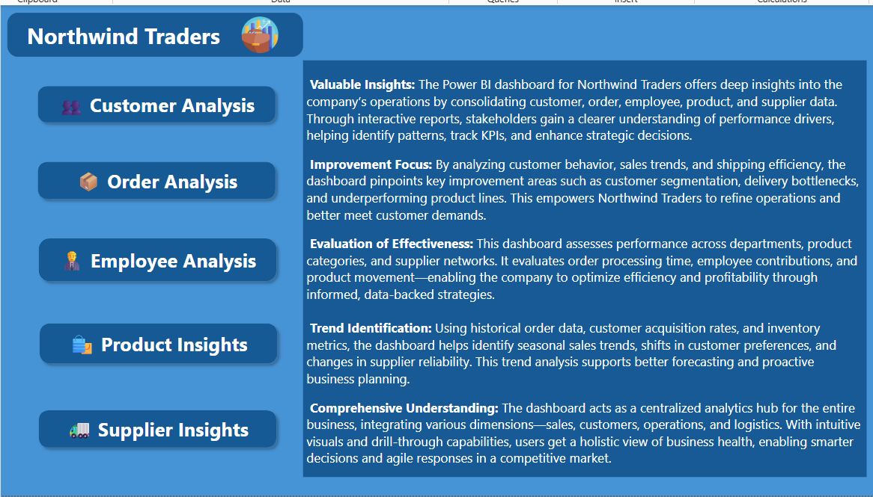

Slide 3



Objective : The objective of this sales dataset analysis is to transform raw transactional data into meaningful business intelligence. By leveraging tools such as Power BI and SQL, we aim to identify patterns in customer behavior, product performance, regional sales trends, and operational efficiencies. The analysis will empower stakeholders to make informed, data-driven decisions that enhance profitability and streamline operations.
Scope of Analysis :This analysis encompasses multiple dimensions of the business:
Sales Performance: Analyze order volumes, revenue trends, and category-level contributions.
Customer Insights: Explore customer distribution by geography, track acquisition trends, and identify high-value customers.
Product-Level Trends: Evaluate product pricing, demand, and stock availability across categories.
Employee Metrics: Assess productivity by tracking orders handled, tenure, and performance indicators.
Shipping & Processing: Review shipping durations and freight costs to optimize logistics.
Data is drawn from various linked tables such as customers, orders, order details , products, employees, and suppliers for a comprehensive analysis.
Goal : The ultimate goal is to create a professional-grade dashboard that highlights critical KPIs and supports strategic initiatives like targeted marketing, product optimization, and customer retention.
By providing a 360° view of the business, this report aims to empower Northwind Traders to scale operation efficiently, improve customer satisfaction, and remain competitive in the wholesale food industry.

Slide 4
💡Insights & Strategic Recommendations : The analysis uncovers several opportunities to enhance business performance. Certain regions show significant sales potential yet remain underdeveloped, indicating a need for targeted marketing efforts to improve market penetration. Additionally, the majority of orders fall below the $5,000 threshold, suggesting room for growth through premium product bundles or strategic upselling initiatives. Low-performing product categories may require promotional campaigns, rebranding, or even discontinuation to streamline inventory and boost profitability. Shipping delays linked to specific vendors highlight the importance of renegotiating contracts or exploring alternative logistics providers to enhance delivery efficiency. Furthermore, the correlation between employee tenure and higher-order values presents an opportunity to implement mentorship programs, leveraging top performers to elevate overall team productivity.
📊 Report & Presentation Summary : The Power BI report offers a user-friendly and visually compelling interface designed for seamless data exploration. With intuitive navigation, interactive filters, and drill-down capabilities, stakeholders can easily analyze trends across customers, orders, products, and operations. The accompanying presentation walks users through key insights, supported by clear visuals and actionable recommendations. This dynamic tool not only consolidates data from multiple sources but also enables real-time decision-making, allowing leadership to quickly identify opportunities and address inefficiencies.
🏆 Business Impact & Scalability : By integrating data from eight-plus sources into a single, cohesive dashboard, this solution provides executives with a comprehensive view of business performance. It enhances operational efficiency by pinpointing bottlenecks in sales, logistics, and workforce management while supporting data-driven strategies for marketing, inventory planning, and staffing. Designed for scalability, the dashboard serves as a flexible template that can evolve alongside the company’s growth, ensuring long-term relevance. Ultimately, it empowers leadership to make informed decisions, optimize resource allocation, and drive sustainable business success.

Slide 5

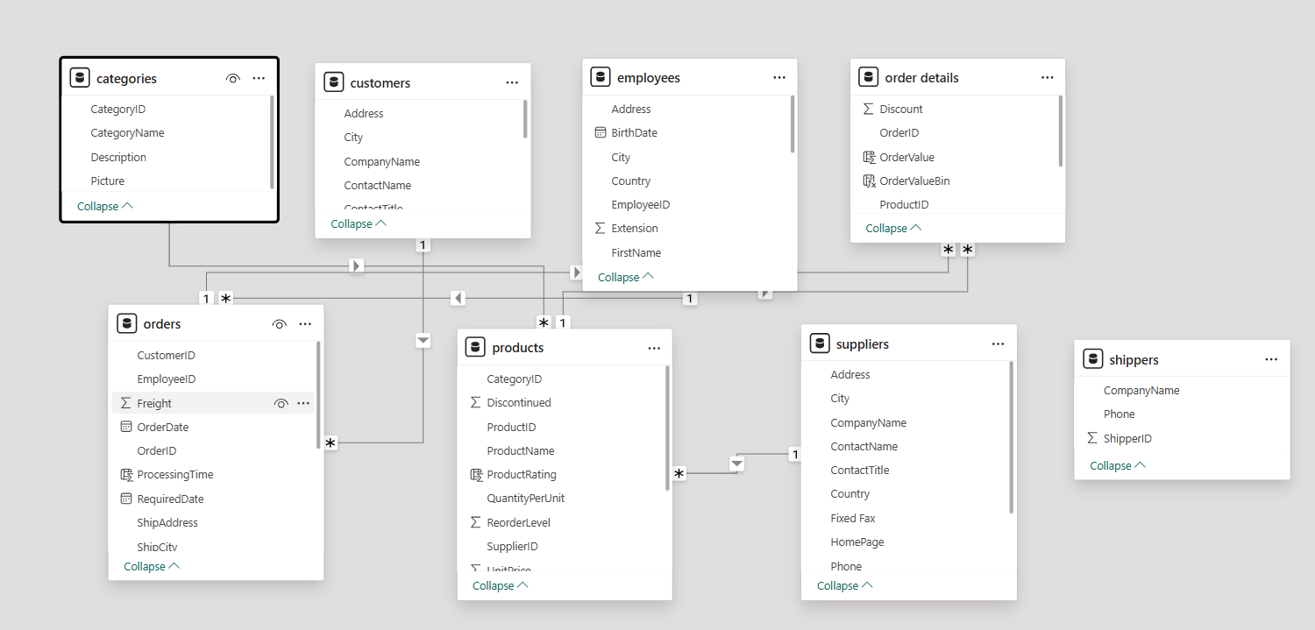
ER DIAGRAM

Slide 6
POWER BI Problem Statements

Slide 7
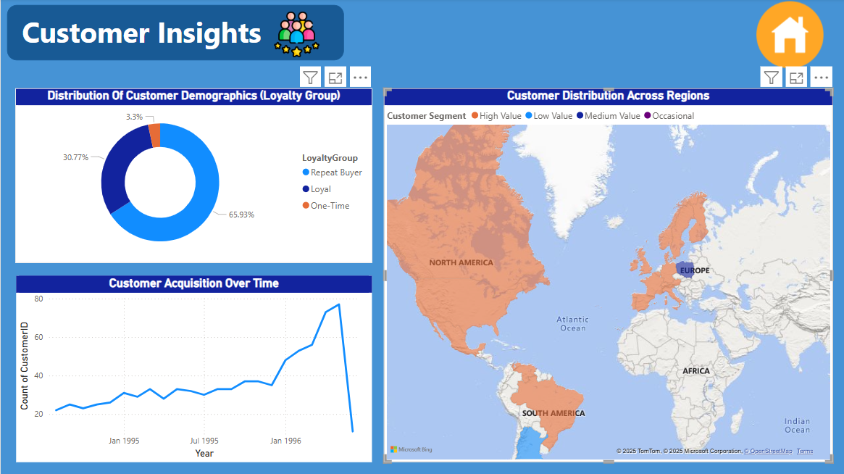

Slide 8
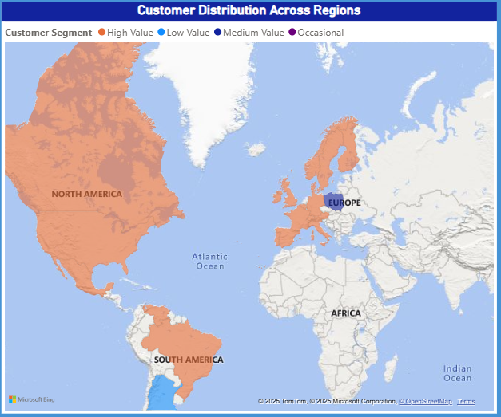
How Does Customer Distribution Vary Across Different Regions Or Customer Segments?
The map shows high-value customers concentrated in North America and Europe, while Africa and South America have mostly low-value and occasional buyers. This reveals untapped potential in emerging markets and suggests targeted strategies—like premium services in strong markets and acquisition campaigns in developing regions—to optimize global customer value.

Slide 9
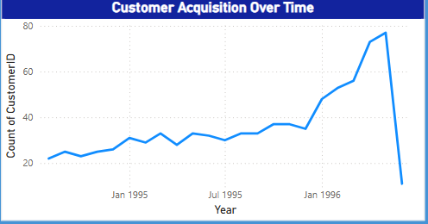
What is the trend in customer acquisition over time?
The customer acquisition trend shows steady growth from early 1995 to 1996, with new customer counts consistently rising each quarter. This upward trajectory indicates successful market expansion efforts during this period, suggesting that the business effectively attracted and retained customers in its early stages. The data provides a positive baseline for evaluating future acquisition strategies.

Slide 10
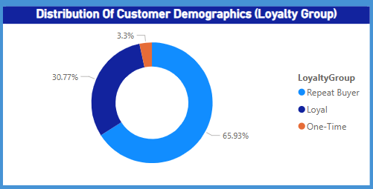
Can We Visualize The Distribution Of Customer Demographics ?
The loyalty distribution reveals that 65.93% of customers are one-time buyers, indicating significant customer retention challenges. While 30.77% are loyal customers, only 3.3% are repeat buyers, suggesting most returning customers don't reach high loyalty tiers. This highlights an opportunity to improve retention strategies—such as loyalty programs or targeted re-engagement campaigns—to convert more one-time buyers into repeat and loyal customers.

Slide 11
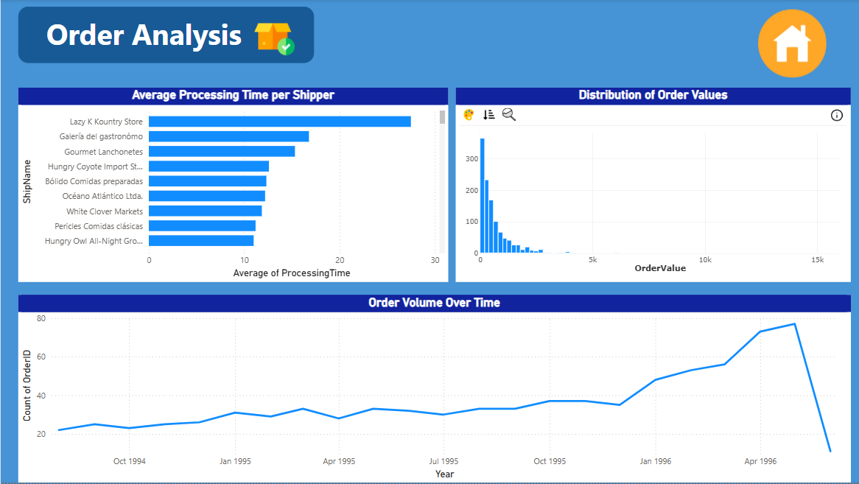

Slide 12
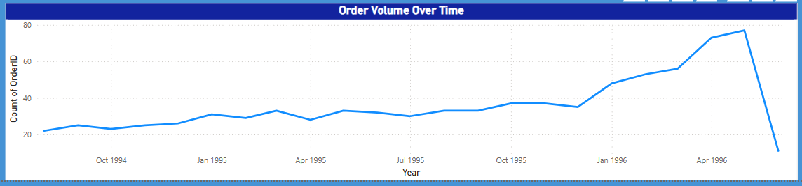
How Does Order Volume Change Over Time?
The order volume data shows consistent growth from October 1994 through April 1996, with noticeable seasonal fluctuations. The upward trend indicates successful business expansion during this period, though the periodic dips suggest potential seasonal demand variations that could inform inventory and marketing planning.

Slide 13
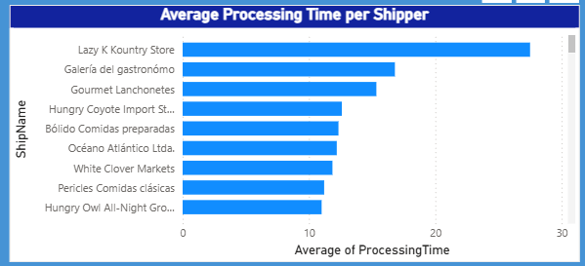
Can We Visualize The Average Order Processing Time Or Shipping Duration Using A Bar Chart Or Box Plot?
The customer acquisition trend shows steady growth from early 1995 to 1996, with new customer counts consistently rising each quarter. This upward trajectory indicates successful market expansion efforts during this period, suggesting that the business effectively attracted and retained customers in its early stages. The data provides a positive baseline for evaluating future acquisition strategies.

Slide 14
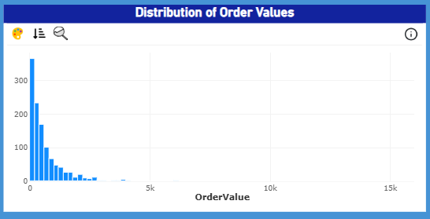
What Is The Distribution Of Order Values?
The order value distribution shows most transactions fall below the $5k threshold, with diminishing frequency as values increase. This concentration in lower-value orders suggests opportunities to introduce premium offerings or bundled deals to elevate average transaction sizes and boost revenue potential.

Slide 15
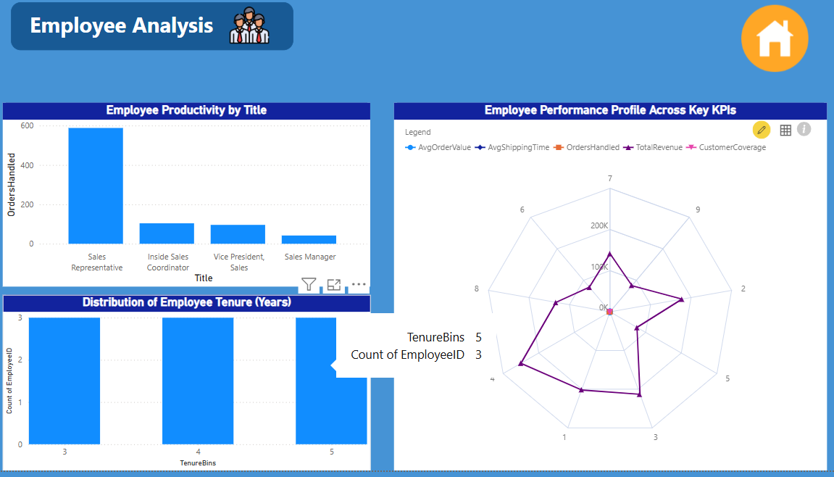

Slide 16
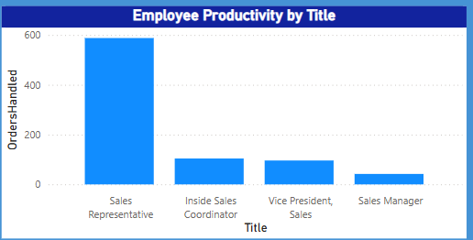
How does employee productivity vary across different departments or job roles?
The employee productivity analysis reveals performance variations across different sales roles. Frontline sales roles (Representatives/Coordinators) drive operational productivity, while leadership positions (VPs/Managers) contribute strategic value. This natural division of labor underscores the importance of both execution and oversight in a high-performing sales organization.

Slide 17
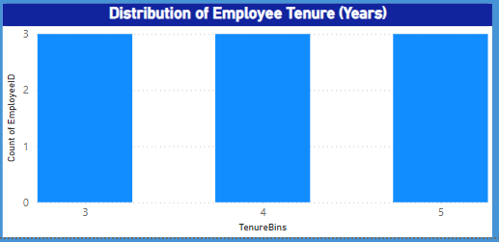
What Is The Distribution Of Employee Tenure?
The tenure distribution shows a concentration of employees with 4-5 years of experience, indicating stable workforce retention. However, the sharp drop-off in newer hires (0-3 years) suggests either recent hiring slowdowns or higher turnover among junior staff. This pattern highlights the need to strengthen recruitment pipelines and early-career retention strategies to maintain balanced team experience levels.

Slide 18
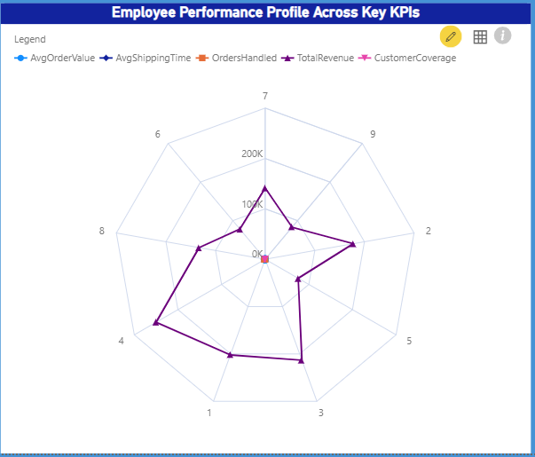
Can We Visualize Employee Performance Ratings Or Kpi’s Using A Radar Chart Or Bullet Graph?
Performance varies significantly, with top employees driving 10-20x more revenue than others. Addressing shipping time inconsistencies and replicating high performers' order-handling techniques could boost overall team productivity. Targeted coaching and workload adjustments may help balance customer coverage gaps.

Slide 19
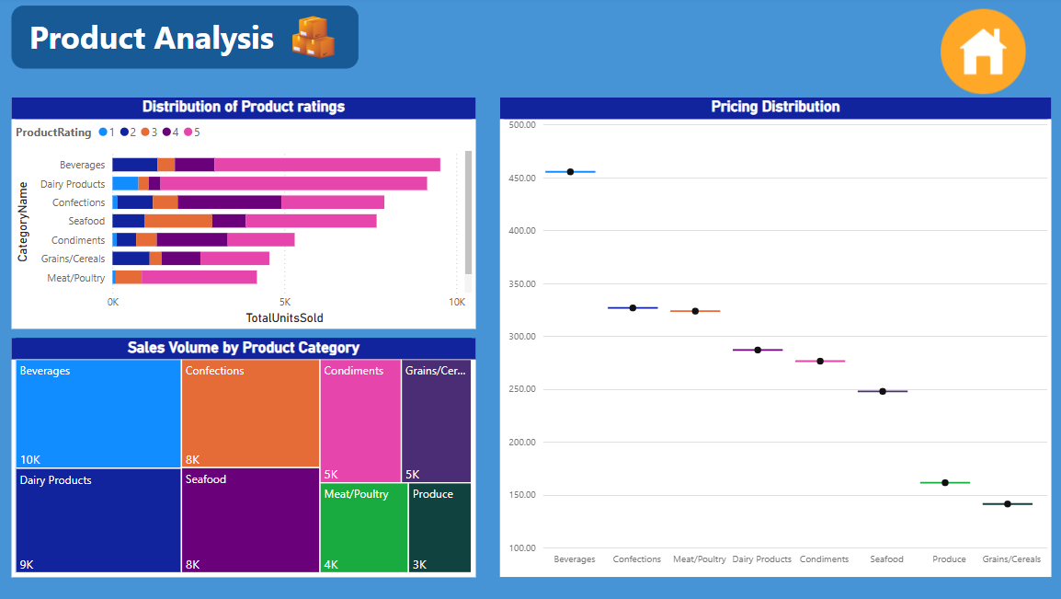

Slide 20
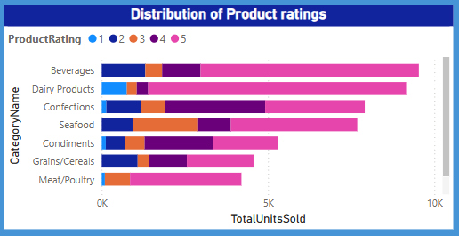
What is the distribution of product ratings or reviews?
The product rating distribution reveals key category performance insights, with most products clustered in the 3-5 star range. Higher-rated categories (Beverages/Dairy) drive the most sales, while lower-rated products (Condiments/Grains) underperform. Improving product quality or marketing for weaker categories could help balance overall portfolio performance and increase revenue potential.

Slide 21
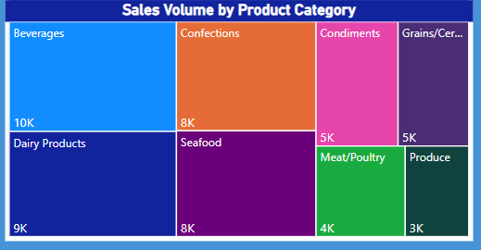
How Does The Sales Volume Vary Across Different Product Categories?
The sales volume data reveals clear category performance tiers, with Beverages (10K units) and Confections (9K units) dominating as top sellers. Mid-range performers like Dairy Products (8K) and Seafood (5K) show steady demand, while Condiments, Grains/Cereals, and Produce (3K-5K) trail significantly behind. This 3-tiered distribution suggests opportunities to either boost marketing for underperforming categories or reallocate resources to capitalize on high-demand segments.

Slide 22
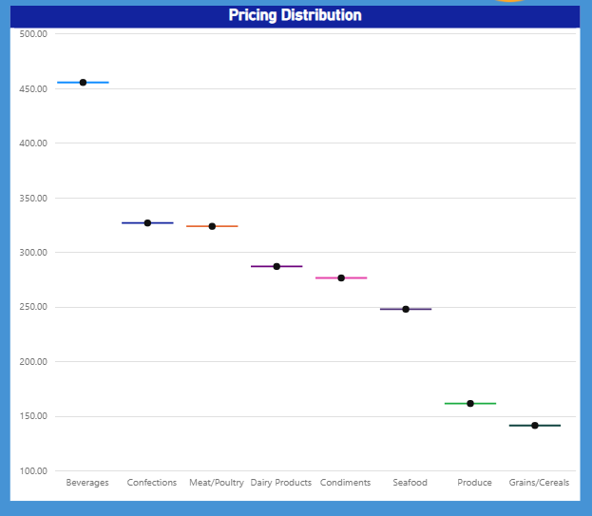
Can We Visualize The Pricing Distribution Of Products Using A Box Plot Or Violin Plot?
Premium categories (Beverages/Confections) sell at 2-3x the price of value staples (Grains/Condiments), with mid-tier products occupying the $250-$350 range. This structured pricing approach allows for targeted margin optimization, particularly in the middle segment where adjustments may be most impactful

Slide 23
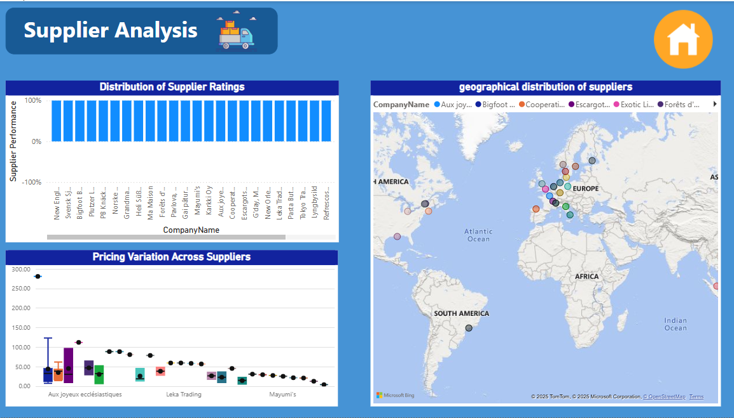

Slide 24
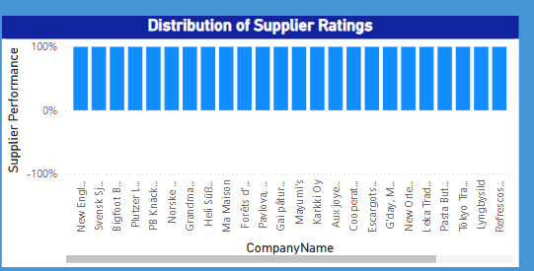
What Is The Distribution Of Supplier Ratings Or Performance Metrics?
The supplier performance distribution reveals significant variability across vendors, with some like New England-based suppliers and Svensk SJ consistently outperforming others. While certain European suppliers (Grandma, PB Kracke) demonstrate strong reliability, several Asia-Pacific vendors (Tokyo Taq, Mayumi's) show room for improvement. This disparity suggests opportunities to consolidate partnerships with top performers while implementing performance improvement plans or renegotiating terms with underperforming suppliers to strengthen overall supply chain efficiency.

Slide 25
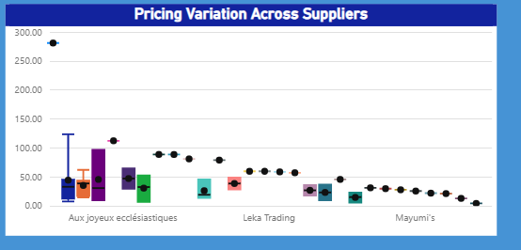
How does the cost or pricing structure vary across different suppliers?
The pricing analysis reveals significant cost variations between suppliers, with Aux Joyeux Ecclésiastiques commanding premium rates (near $300) while Mayumi's operates at substantially lower price points (around $50-$100). This 3:1 price differential suggests either major differences in product quality/sourcing between suppliers, or opportunities to negotiate better terms with higher-cost vendors.

Slide 26
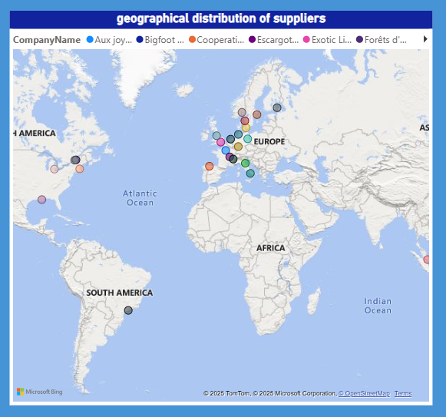
Can We Visualize The Geographical Distribution Of Suppliers Using A Map Or Bubble Chart?
The supplier geographic distribution shows heavy concentration in Europe and America, with minimal presence in Africa and South America. This regional imbalance suggests potential supply chain vulnerabilities and missed opportunities in emerging markets. Businesses could diversify their supplier base by developing partnerships in underrepresented regions to mitigate risks and tap into new sourcing advantages.

